Slide 1
Java Lecture 14

Slide 2
AWT vs. Swing
AWT is the old GUI library.
Swing is the new GUI library. Swing uses the AWT event model. It has richer set of GUI elements. It provides more consistent user experience. It less depends on the underlying platform. It can give a specific look and feel to the program, like Motif, Windows and Metal

Slide 3
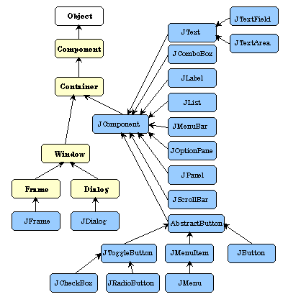
Swing Components
Swing classes are in
the javax.swing package.

Slide 4
Creating a Frame
Frame is a top level window. Being a window, its decorations are drawn by the underlying windowing system. Frames, like many other Swing components, can contain other Swing components.
Methods:
    setTitle(String);
    setResizable(boolean)
    setIcon(Image)
    setLocation(x, y)
    setBounds(x, y, width, height)

Slide 5
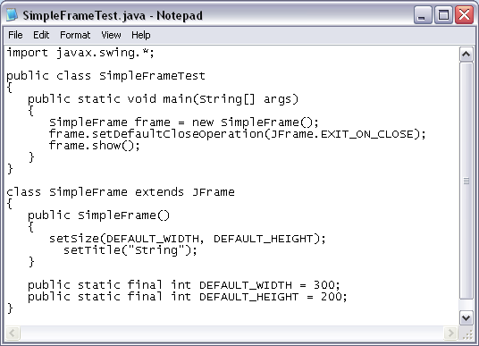
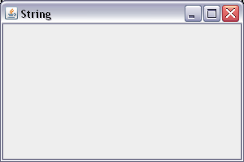
Creating a Frame

Slide 6
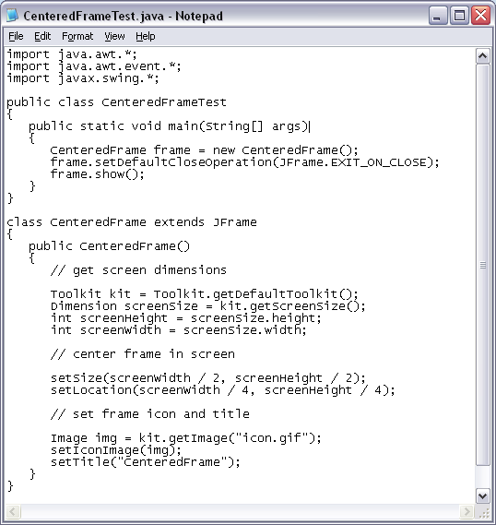

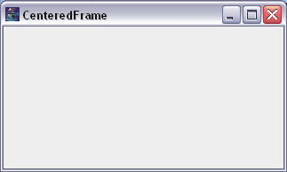
Creating a Frame

Slide 7
Graphics Context
A graphics context enables drawing on Java GUI components by controlling how the graphic is drawn on screen. It controls the color, font, line thickness and fill pattern when drawing graphical figures.
paintComponent() method should be overridden for drawing graphical figures on the Swing components. The overridden definition should call the super.paintComponent() in order to perform the default drawing.
Example

Slide 8
2D Shapes
Line2D, Rectangle2D and Ellipse2D. These classes implement the Shape interface
In order to be able to work with these classes, we need a reference of type Graphics2D. We will be casting the Graphics object to Graphics2D type.
Example

Slide 9
Colors
Colors are created with RGB(Red/Green/Black) values. Values for R, G and B could be integers from 0 to 255, or floats from 0.0 to 1.0. Color class defines constants for some common colors.
setPaint() method of the Graphics2D objects changes the foreground drawing color.
setBackground() method inherited from the Component class changes the background color.
fill() method fills a rectangular area with the foreground color
Example:

Slide 10
Fonts
Use GraphicsEnvironment.getLocalGraphicsEnvironment().getAvailableFontFamilyNames() to get an array of all font families.
Use Font(name, style, size) to create a font object.
Use getName(), getStyle(), getSize(), getFamily() methods on font objects.
Use setFont() method on the Graphics object to use a particular font.
Use drawString() method on the Graphics object for printing text on screen.

